Slide 1

IIE BACHELOR OF COMPUTER AND INFORMATION SCIENCES IN APPLICATION DEVELOPMENT
(BCA2)
INFORMATION SYSTEMS 2B
INSY6212w
Felicia Jagdeo
fjagdeo@emeris.ac.za

Slide 2
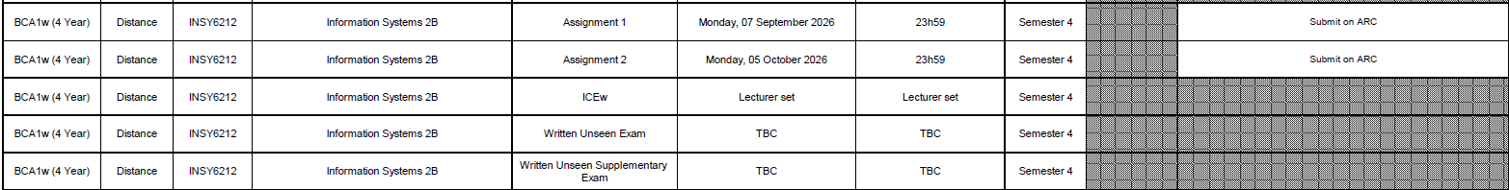
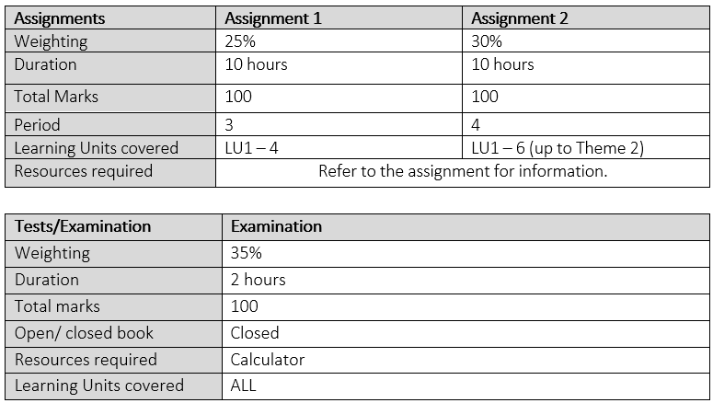
P.A.S
Integrated Curriculum Engagement (ICE)
Minimum number of ICE activities to complete | 4
Weighting towards the final module mark | 10%

Slide 3

Module resources
Textbook
Software and Additional Resources
ARC
Gido, J.; Clements, JP.; Baker, R.; Harinarain, N.; and Eresia-Eke, C. 2022. Successful Project Management in South Africa. 2nd edition. Cengage Learning. 9781473780415
Online content and activities
Microsoft Project, latest (e.g., 2016 Edition)
The prescribed articles and resources for this module are in the MO
Online Articles and Resources

Slide 4
Module outline
Introduction to Project Management
Project Identification and Selection
Project Proposal
Project Planning
Introduction to Project Software
Project Resource Utilisation and Schedule Development
Project Costs and Budgets
Project Risk Management
Project Manager, Project Teams and Organisational Structures
1
2
3
4
5
6
7
8
9

Slide 5

Module outcomes:
MO1 | Demonstrate Knowledge of the key concepts, principles and best practices of information technology project management in organization’s
MO2 | Create an integrated project solution using effective information technology project management methodology
MO3 | Demonstrate the use of project tools and techniques to support the management of project lifecycle an information technology project environment

Slide 6
Introduction:
Individuals need hard information and real skills to work successfully in a project environment and to accomplish project objectives.
This module will challenge you to think critically about project management principles and to apply them within the context of the real world.
All members/ people on the project team must have the knowledge and skills to work effectively together in a project environment.
People do not become project managers by reading books; they become project managers by first being effective project team members.
Therefore, this module/ course will provide the foundation that individuals need to be effective members of project teams and thereby boosting everyone’s potential to rise to the challenge of managing teams and projects.

Slide 7
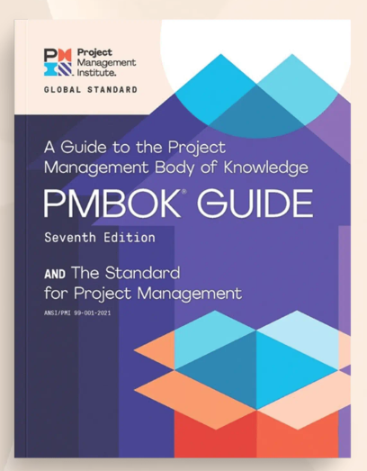
PROJECT MANAGEMENT BODY OF KNOWLEDGE
What is the PMBOK Guide?
  It’s a global standard that provides best practices, guidelines, and tools to help manage projects effectively.
Notes:
What is the PMBOK Guide? Think of it as a rulebook for project managers—just like software developers follow coding best practices, project managers follow PMBOK to run projects successfully.
The PMBOK Guide is like a roadmap for managing IT projects. It helps ensure that software development, system upgrades, and other IT projects are completed on time, within budget, and with high quality.
For 2rd-year computer science students, understanding PMBOK means you’ll be better prepared for real-world IT project management roles when you get into the world of work

Slide 8
PROJECT MANAGEMENT BODY OF KNOWLEDGE
Why is the PMBOK Guide Important?
  Standardisation
  Reduces Project Failures
  Widely recognised
  Better resource management
Notes:
Standardization – Just like coding conventions (best practices) (e.g., PEP8 for Python), PMBOK provides a standardized way to manage projects. This makes it easier to work in teams and communicate with stakeholders.
Reduces Project Failures – IT projects often fail due to poor planning, unclear requirements, or bad risk management. PMBOK helps avoid these pitfalls.
Widely Recognized – Many companies worldwide follow PMBOK, so understanding it will make students more employable.
Better Resource Management – Helps in managing time, cost, scope, and quality efficiently, which is critical for IT projects

Slide 9
PROJECT MANAGEMENT BODY OF KNOWLEDGE
How is the PMBOK relevant to IT Project Management?
  Project Initiation
  Project Planning
  Project Performing – Monitoring and Controlling
  Project Closure
Notes:
In your IT Project Management module, you are going to learn how to plan, perform, and complete software or IT-related projects. PMBOK provides structured guidance for doing this effectively. Let’s look at how it applies:
Project Initiation
Example: Before building an e-commerce website, you must define the scope, budget, and stakeholders. PMBOK provides processes for project charter creation and stakeholder identification.
Project Planning
Example: If you’re developing a mobile app, PMBOK helps you plan tasks like defining requirements, creating timelines, and setting a budget. It includes tools like Work Breakdown Structure (WBS) and Gantt charts.
Project Execution
Example: While coding a new software system, PMBOK guides how to manage teams, track progress, and communicate with clients to ensure smooth execution.
Monitoring & Controlling
Example: If an IT project is delayed, PMBOK provides techniques like Earned Value Management (EVM) to measure progress and Risk Management strategies to mitigate issues.
Project Closure
Example: Once a web application is deployed, PMBOK ensures proper documentation, testing, and client feedback collection before officially closing the project.

Slide 10
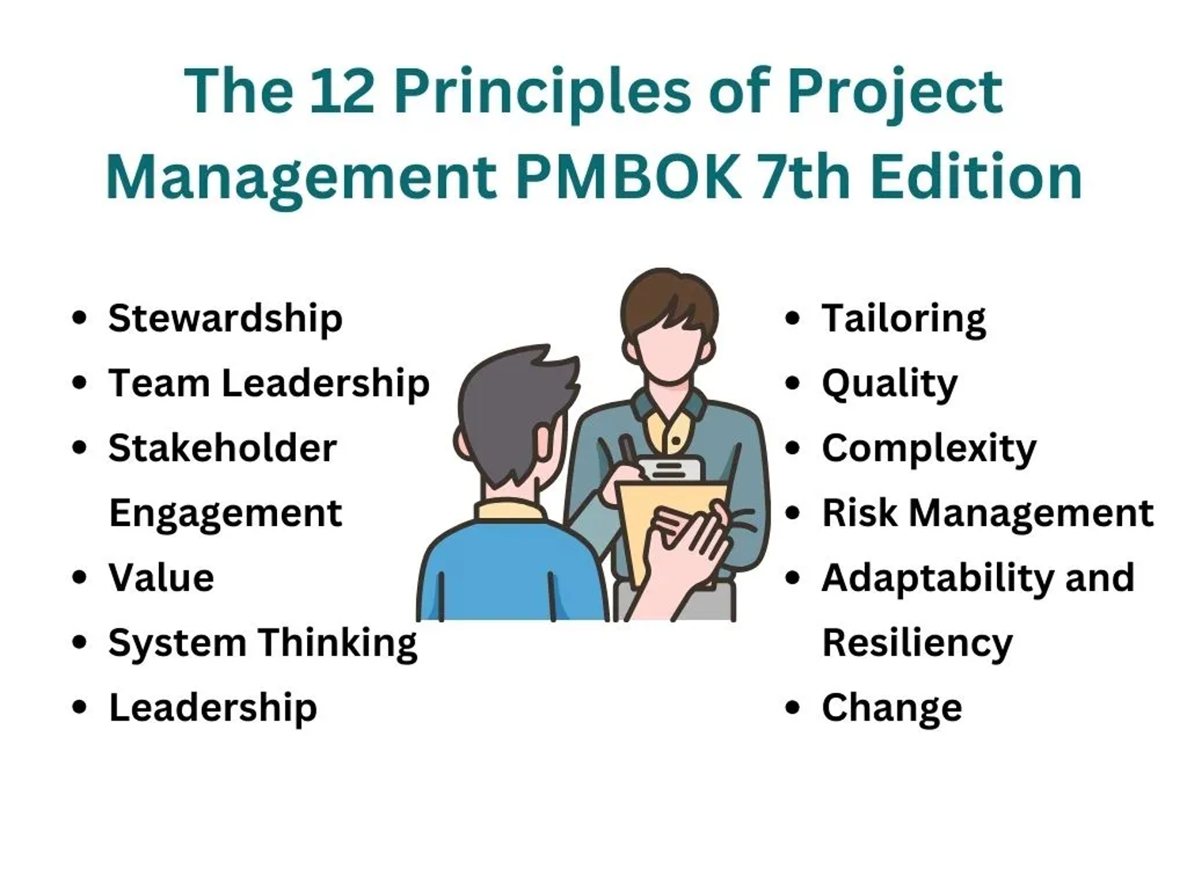
Notes:
The PMBOK Guide (7th Edition) emphasizes 12 principles and 8 performance domains.
The 12 principles act like core values or guiding rules that every project manager should follow, regardless of industry. These principles ensure that projects run smoothly and successfully.
Think of them like coding best practices
For example, in software development, you follow clean code principles (e.g., DRY – Don't Repeat Yourself, or SOLID principles).
In project management, PMBOK provides 12 principles to guide decision-making.
Stewardship – Act responsibly and ethically in managing projects.
Example: If you’re handling an IT budget, don’t overspend just because you can.
Team – Build a strong, collaborative team.
Example: Encourage teamwork between developers, testers, and designers.
Stakeholders – Engage stakeholders throughout the project.
Example: Keep clients and users informed about software updates.
Value – Focus on delivering value to customers and organizations.
Example: Prioritize features that customers actually need instead of adding unnecessary complexity.
Systems Thinking – Understand how different project parts interact.
Example: Changing the database structure may impact the entire software architecture.
Leadership – Motivate and guide the team effectively.
Example: As a project lead, help junior developers instead of just giving orders.
Tailoring – Adjust your approach based on the project needs.
Example: A small mobile app project doesn’t need the same level of documentation as a large banking system.
Quality – Ensure the project meets high standards.
Example: Software should be bug-free and optimized before release.
Complexity – Recognize and manage project challenges.
Example: Handling a distributed development team in different time zones requires extra planning.
Risk Management – Identify and address risks proactively.
Example: If a key developer might leave mid-project, have a backup plan.
Adaptability & Resilience – Be flexible and handle changes effectively.
Example: If user testing shows a feature is unnecessary, be ready to pivot.
Change Management – Guide teams through changes smoothly.
Example: When migrating from legacy systems to cloud-based solutions, manage team expectations properly.

Slide 11
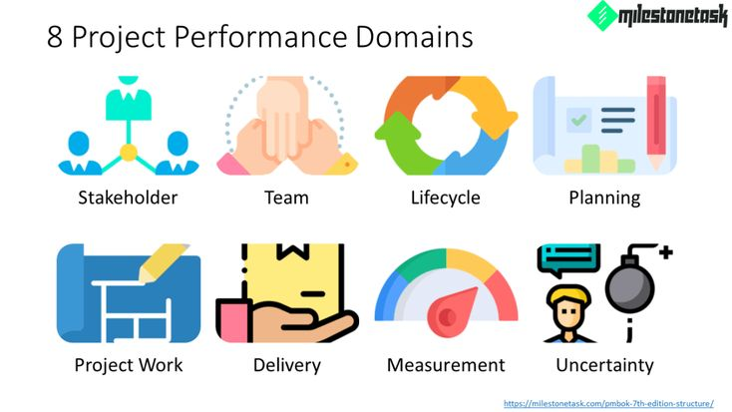

Notes:
While the 12 principles guide behaviour, the 8 performance domains focus on key aspects of project execution.
Think of them like different parts of software development
For example, when building an application, you have frontend, backend, database management, and security—each part is important.
Similarly, in project management, the 8 domains ensure that all key areas are covered.
Stakeholders – Managing people who are impacted by the project.
Example: Developers, clients, end-users, and testers all need proper communication.
Team – Building, managing, and leading the project team.
Example: Ensuring software developers, testers, and designers work together effectively.
Development Approach & Life Cycle – Choosing the right project methodology (e.g., Agile, Waterfall).
Example: For a mobile app, Agile might be better for continuous updates.
Planning – Creating the roadmap for project success.
Example: Breaking down a website project into phases: UI design, backend development, testing, and deployment.
Project Work – Managing execution and ensuring smooth progress.
Example: Making sure coding, testing, and debugging happen on schedule.
Delivery – Ensuring the project delivers value.
Example: A software system should be fully functional and meet client requirements.
Measurement – Tracking project performance and making improvements.
Example: Using tools like burndown charts or velocity tracking in Agile development.
Uncertainty & Risk – Managing unknown challenges and risks.
Example: If a cloud provider has unexpected downtime, have a backup plan.

Slide 12

Project Management Concepts

Slide 13
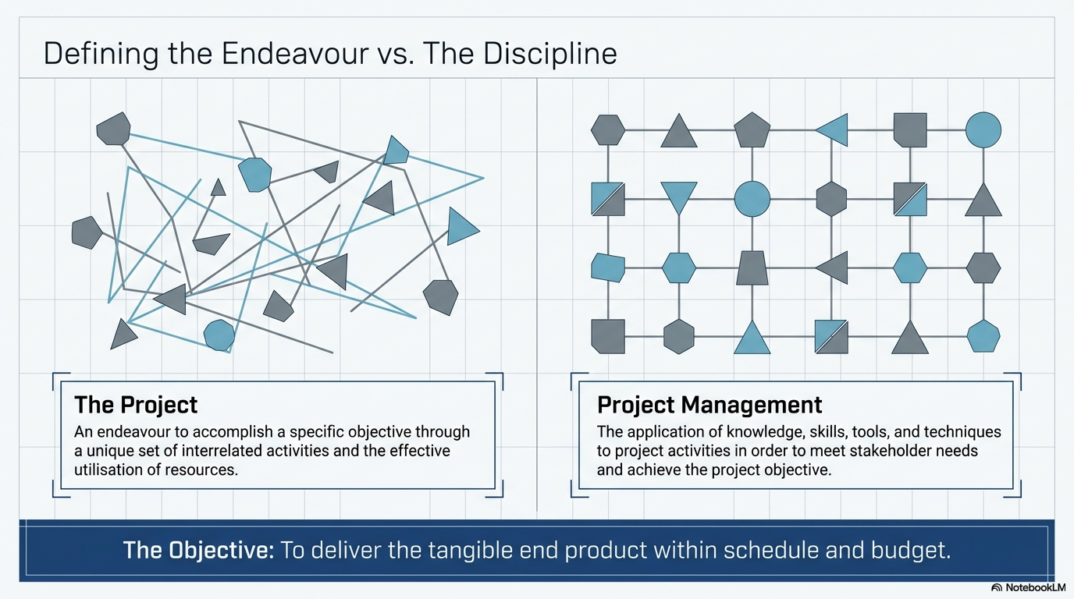
Notes:
Theme 1: Project Management for Information Technology Projects
Project management is defined by the PMBoK as “the application of knowledge, skills, tools and techniques to project activities in order to meet stakeholders needs and expectations from a project”
Project management is also defined as “the application of processes, methods, knowledge, skills and experience to achieve project objectives”
Planning, scheduling, team building, communicating and leading are all part PM with the organization and necessary in the life of a project
Project management is the most efficient way of introducing change
Change Management: Project managers would have employed change management processes to evaluate proposed changes, assess their impacts, and implement them effectively while minimizing disruptions.
A project is an endeavour to achieve a specific objective through a unique set of interrelated activities and the effective utilisation of resources. The following attributes help define a project:

Slide 14
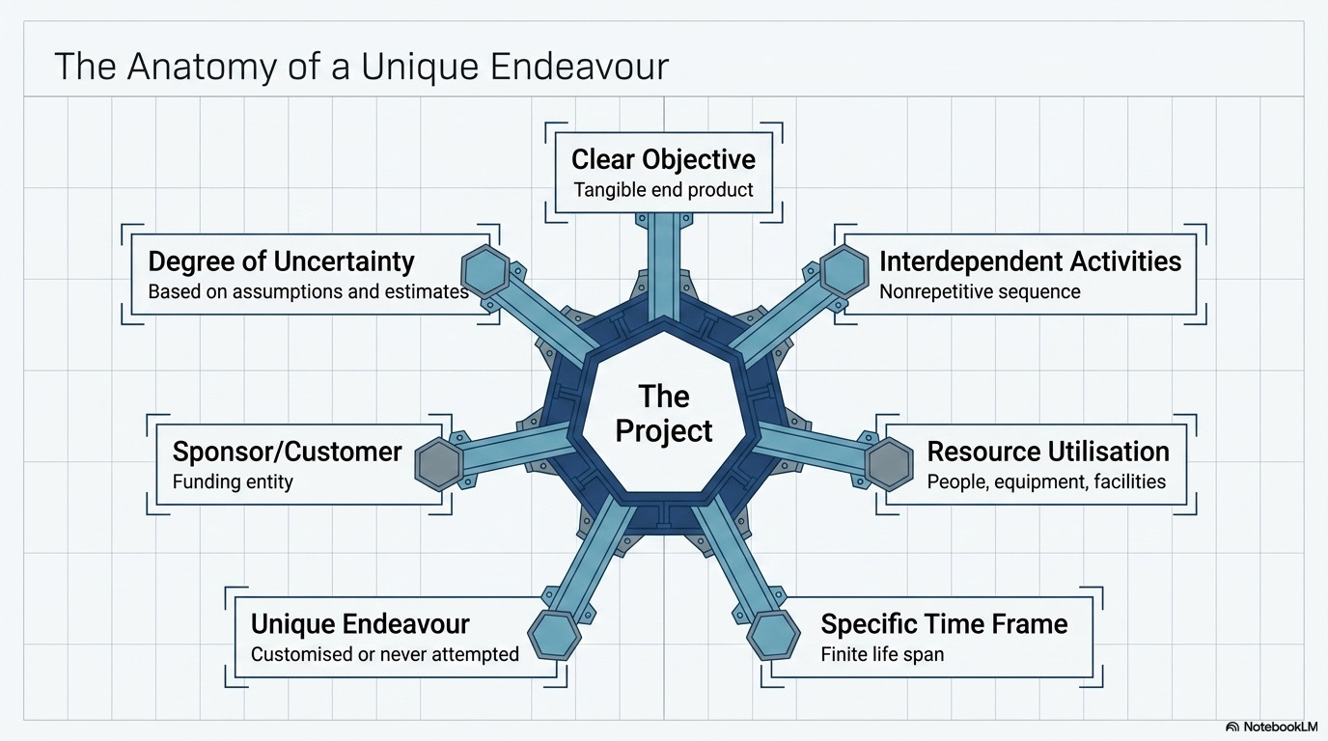
Notes:
Project atributes
A project has a clear objective that establishes what is to be achieved. It is the tangible end product that the project team must produce and deliver. The project objective is usually defined in terms of end product or deliverable, schedule, and budget. Furthermore, it is expected that the work scope will be achieved in a quality manner and to the customer’s satisfaction.
A project is carried out through a series of interdependent activities in a certain sequence in order to achieve the project objective.
A project utilises various resources to carry out the activities – resources include people, organisations, equipment, materials, facilities
A project has a specific time frame, or finite life span – a start time and a date by which the objective must be achieved.
A project may be a unique or one-time endeavour such as developing a new product, building a house, or planning a wedding.
A project has a sponsor or customer that provides the funds necessary to achieve the project. In a business setting, the customer can be internal or external to your organisation.
Finally, a project involves a degree of uncertainty and is based on certain assumptions and estimates for the project budget, schedule, and work scope.

Slide 15
A project includes:
Start and Finish
Lifecycle
Budget
Non-repetitive
Resources
Single point of responsibility
Fast-tracking
Team roles

Slide 16
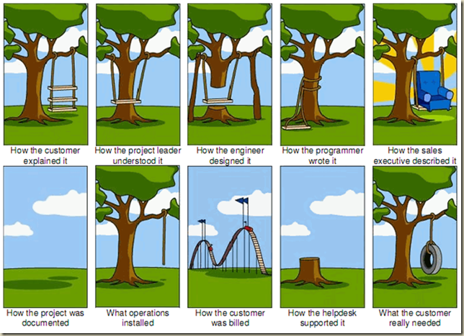
Project Management vs IT Project Management
Project management vs IT project management
Is there a difference?
If so, how are they different?
Notes:
Project management is “the application of knowledge, skills, tools and techniques to deliver something of value to people”
Project management means the process of leading a team to hit goals or complete deliverables within a set timeframe
Project management involves project documentation, planning, tracking and communication all with the goal of delivering work successfully with the constraints of time, scope and budget.
Project Management is about communication, teamwork, analysis, budget, planning, problem solving, milestones, control, risks, goals, deadlines
IT Project Management:
An information technology (IT) project is a type of project that deals with IT infrastructure, information systems or computers.
IT project management is the planning, scheduling, execution, monitoring and reporting of IT projects
Examples of IT Projects:
A large network of healthcare providers updates its information systems and procedures to reduce hospital acquired diseases
A team of students creates a smartphone application and sells it online
A company develops a driverless car
A company develops a new system to increase sales force productivity and customer relationship management that will work on various laptops, smartphones and tablets

Slide 17
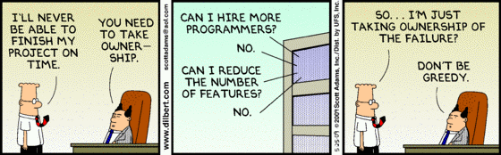
Have you ever been in a situation where you could not complete a task because you were restricted or prevented to do so?
    How would you deal with such a situation/s?
Notes:
This will lead us to understanding project constraints

Slide 18
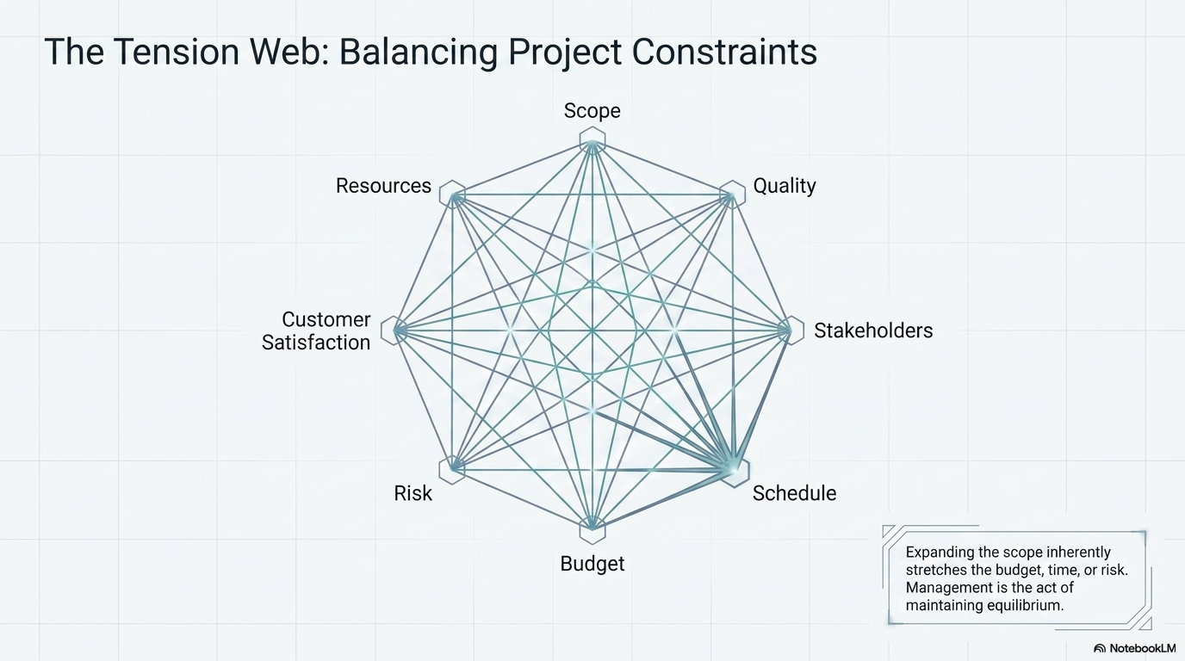
Notes:
The successful achievement of the project objective is usually constrained by many factors, including scope, quality, schedule, budget, resources, risks, customer satisfaction, and stakeholder support.
Project scope is all the work that must be done in order to produce the project deliverables, satisfy the customer that the deliverables meet the requirements or acceptance criteria, and achieve the project objective.
Quality expectations must be defined from the onset of the project. The project work scope must be achieved in a quality manner and meet specifications.
The schedule for a project is the timetable that specifies when each task or activity should start and finish. The project objective usually states the time by which the project scope must be completed in terms of a specific date agreed upon by the sponsor and the organisation performing the project.
The budget of a project is the amount the sponsor or customer has agreed to pay for acceptable project deliverables. The project budget is based on estimated costs associated with the quantities of various resources that will be used to perform the project.
Various resources are needed to perform the project tasks and achieve the project objective. Resources include people, materials, equipment, facilities, and so on.
Risks adversely affect achieving the project objective.
Customer satisfaction goes beyond just completing the project scope within budget and on schedule or asking if the customer is satisfied at the end of the project. It means not only meeting the customer’s expectations but also developing and maintaining an excellent working relationship throughout the project.
The project manager and team need to build relationships with and engage the various stakeholders who may be affected by the project, in order to gain their support
To help assure the achievement of the project objective, it is important to develop a plan before starting the project work rather than starting without a plan. Lack of a plan decreases the chances of successfully achieving the full project scope within budget and on schedule.

Slide 19
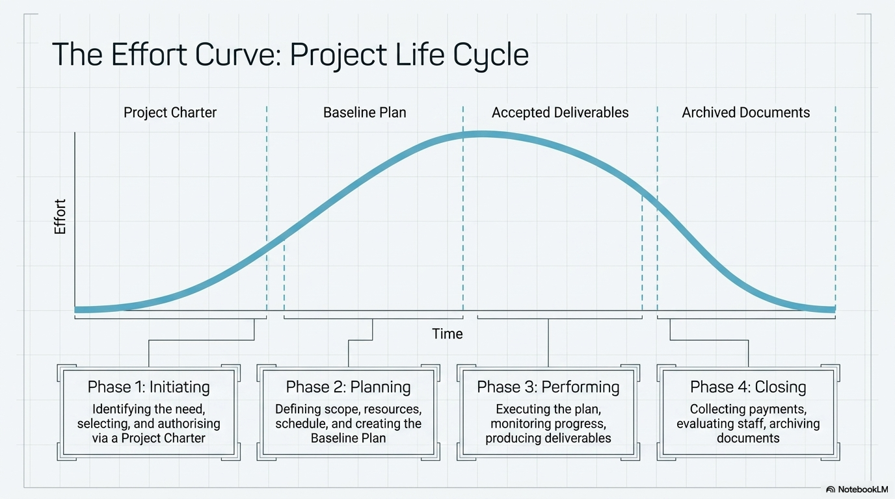
Notes:
Theme 2: Project Management Concepts
The generic project life cycle has four phases: initiating, planning, performing, and closing the project. See Figure 1.2.
The time span of each phase and the associated level of effort will vary depending on the specific project.
Project life cycles vary in length from a few weeks to several years, depending on the content, complexity, and magnitude of the project.
Initiating Phase
In the initiating phase, projects are identified and selected and then authorized using a document referred to as a project charter.
The first phase of the project life cycle:
Involves the identification of a need, problem, or opportunity and can result in the sponsor authorising a project to address the identified need or solve the problem.
May take several months to identify the need, gather data, and define the project objective.
It is very important to define the right need. Needs are often defined as part of an organisation's strategic planning process.
organisations must have a project selection process to determine what projects to pursue.
The project charter includes:
Rationale, or justification, for the project
Project objective and expected benefits
General requirements and conditions such as amount of funds authorised, required completion date, major deliverables, and required reviews and approvals; and key assumptions
If it decides to use external resources, an organisation develops a request for proposals, or RFP, asking contractors to submit proposals describing how to address the need, associated costs, and schedule.
Planning phase
The planning phase is the second phase of the project life cycle. It includes defining the project scope, identifying resources, developing a schedule and budget, and identifying risks, all of which make up the baseline plan for doing the project work.
Shows how the project scope will be achieved within budget and on schedule
Plan the work and work the plan
The detailed plan results in a baseline plan
What needs to be done – scope, deliverable
How it will get done – activities, sequence
Who will do it – resources, responsibilities
How long it will take – durations, schedule
How much it will cost – budget
What the risks are
Benchmark the baseline plan to allow for comparison with actual progress.
Include the people that will actually do the work in the planning process.
They have knowledge of detailed activities to be done.
Participation also builds commitment.
Performing phase
In the performing phase, the project plan is executed and work tasks are carried out to produce all the project deliverables and to achieve the project objective.
The project progress is monitored and controlled to assure the work remains on schedule and within budget, the scope is fully completed according to specifications, and all deliverables meet acceptance criteria.
Any changes need to be documented, approved, and may be incorporated into an updated baseline plan.
This is the third phase of the project life cycle.
The project manager leads the project team to complete the project.
The pace of the project increases as more and various resources are involved in the project.
It is necessary to monitor and control the project's progress by comparing achievements to the baseline plan.
Corrective actions are taken if a project is off track.
Changes are managed and controlled through documentation, approval, and communication with agreement between the sponsor and the contractor.
Some change is trivial
The end of the phase, customer satisfaction, is achieved when the work and deliverables are accepted by the customer and the project objective is achieved.
Several alternative actions may be evaluated to determine the best approach to bring the project back within the scope, schedule, and budget constraints of the project.
Determine if any sacrifices to scope, budget, schedule, or quality are necessary to achieve the project.
The costs of changes vary with the timing in the project – generally, the later in the project that changes are identified, the greater their effect on achieving the project objective.
Closing phase
In the closing phase, project evaluations are conducted, lessons learned are identified and documented to help improve performance on future projects, and project documents are organised and archived.
This is the final phase of the project life cycle
It includes a variety of actions such as:
Collecting and making final payments
Staff recognition and evaluation
Conducting a post project evaluation
Documenting lessons learned
Archiving project documents
Using a knowledge base to record lessons learned and post-project evaluation
A knowledge base is helpful to retrieve the lessons and information that can help with doing business with the customer or other customers in the future.

Slide 20
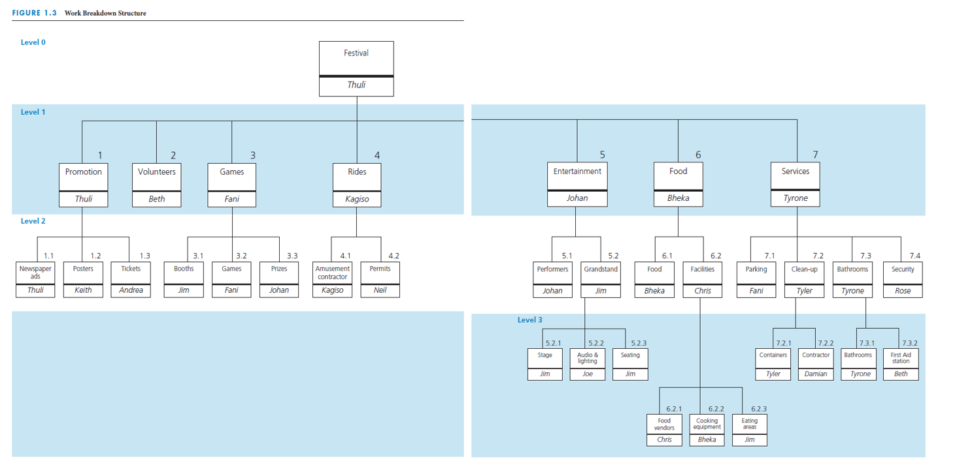
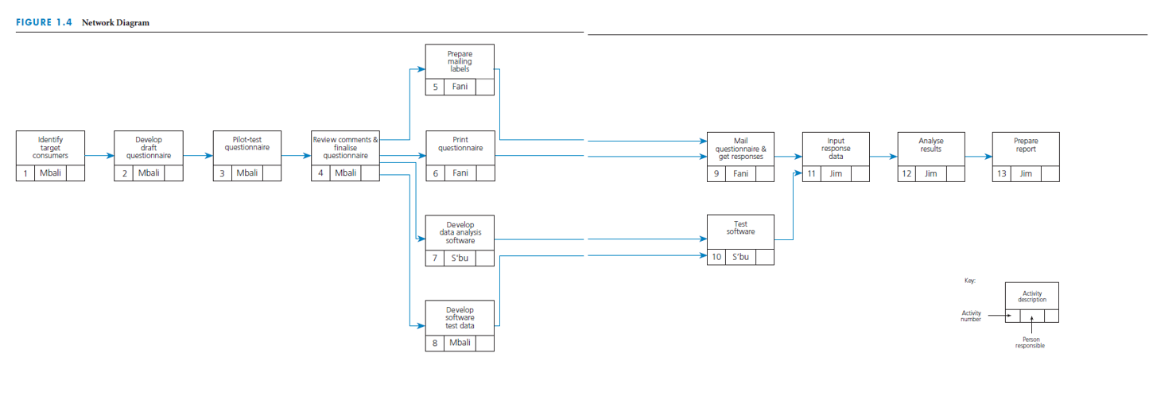
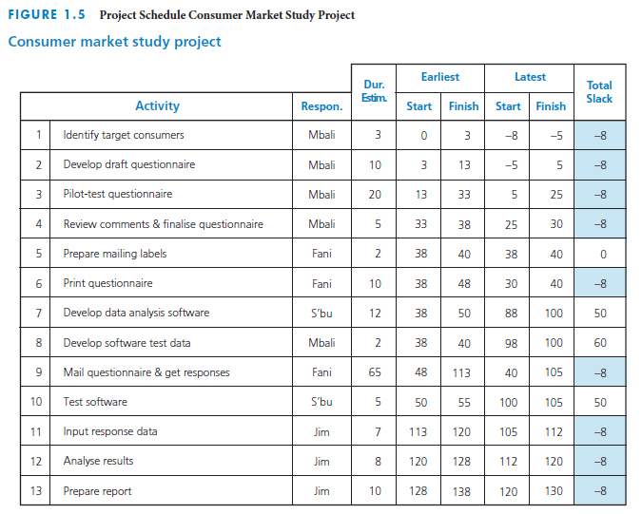
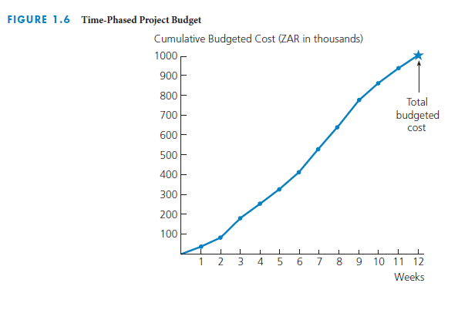
Project Planning Process
Establish project objective
Define scope
Create WBS
Assign responsibility
Define specific activities
Sequence activities
Estimate activity resources
Estimate activity durations
Develop project schedule
Estimate activity costs
Determine budget
Notes:
Project planning process
Project management is planning, organising, coordinating, leading, and controlling resources to achieve the project objective. The project management process involves planning the work (establishing the plan) and then working the plan (executing that plan).
There are many steps in the project planning process, as you can see on this slide.
Establish project objective – agreed upon by sponsor and contractor
Define scope – includes customer requirements, defines major work tasks, lists deliverables and associated acceptance criteria
Create a work breakdown structure, or WBS – a hierarchical decomposition of the project scope into work elements to be executed by the project team and produce the project deliverables
Assign responsibility – the person or organisation responsible for each work item is identified
Define specific activities – develop a list of detailed activities needed to perform each work package and produce any required documents
Sequence activities – create a network diagram that shows the necessary sequence and dependent relationships
Estimate activity resources – determine the types of resources needed for each activity. These may include people, materials, or equipment that are internal or external to the contractor.
Estimate activity durations – time estimates for how long each activity will take to be completed based on the estimate of resources available applied to each activity
Develop project schedule – determine the start and finish times for each activity to complete the project by its required completion date
Estimate activity costs – use the appropriate labor cost or unit cost rate for each type of resource to determine the cost of each activity
Determine budget – aggregate the costs associated with each activity and each work package and add indirect costs and profits to determine the costs of completing the project. Allocate the costs over time to determine the time-phased budget.

Slide 21
Create WBS and assign responsibility
Notes:
Create WBS and assign responsibility
A work breakdown structure, or WBS, is a hierarchical decomposition of the project scope into work elements to be executed by the project team and produce the project deliverables.
You can see a WBS in this slide.
Assigning responsibility involves determining who will be the person or organisation responsible for each work item in the WBS.

Slide 22
Sequence activities
Notes:
Sequence activities
The figure on this slide shows a network diagram that reveals the sequence of activities for a project.
Sequencing activities involves creating a network diagram that shows the necessary sequence and dependent relationships in a project.

Slide 23
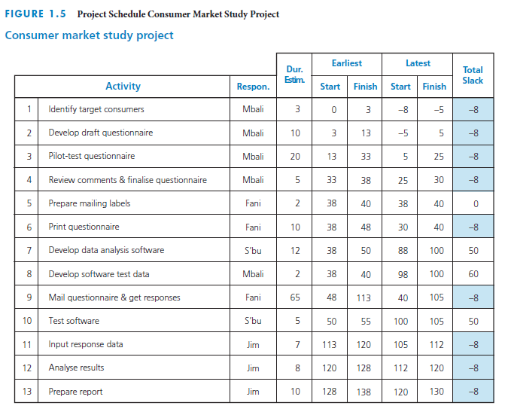
Develop the project schedule
Notes:
Develop the project schedule
This table shows the project schedule for a consumer market study project.
Developing project schedule involves determining the start and finish times for each activity in order to complete the project by its required completion date.

Slide 24
Determine budget
Notes:
Determine budget
Here we see a time-phased project budget.
Determining the budget involves aggregating all the costs associated with each activity and each work package and adding indirect costs and profits to determine the costs of completing the project.
Allocate the costs over time to determine the time-phased project budget.

Slide 25
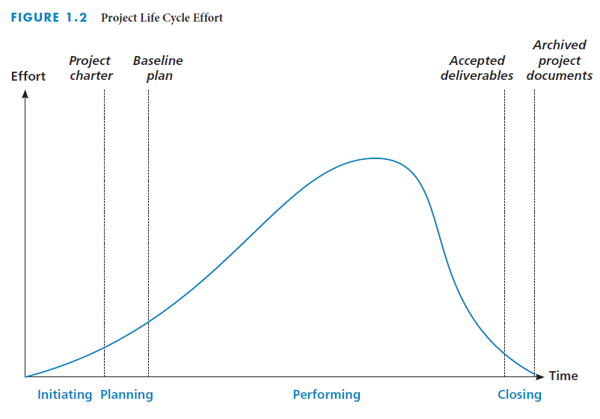
Execute the project plan
Perform the work
Monitor and control progress
Control changes
Notes:
Execute the project plan
Once a baseline plan has been established, the plan must be executed. The executing process involves performing the work according to the plan, monitoring and controlling the work, and controlling for changes so that the project scope is achieved within the budget and schedule, to the customer’s satisfaction.

Slide 26
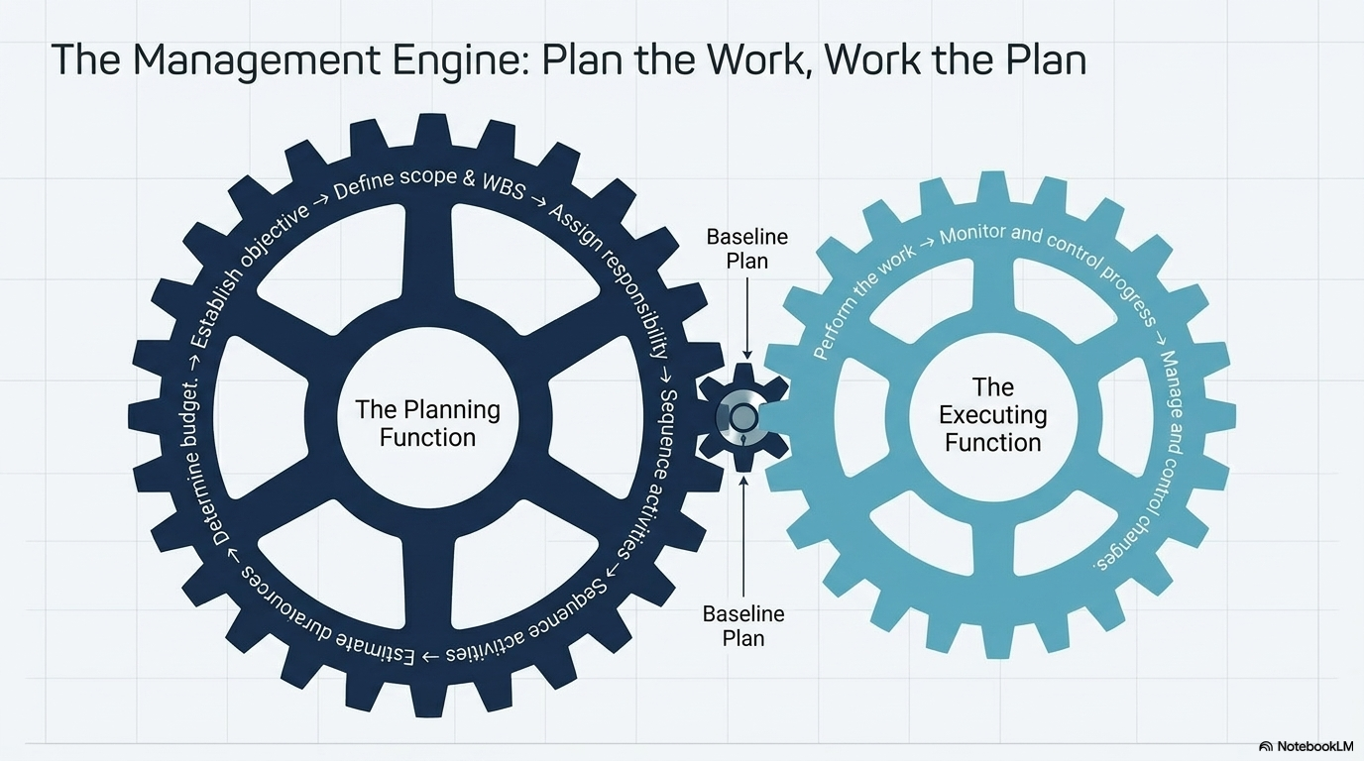

Slide 27
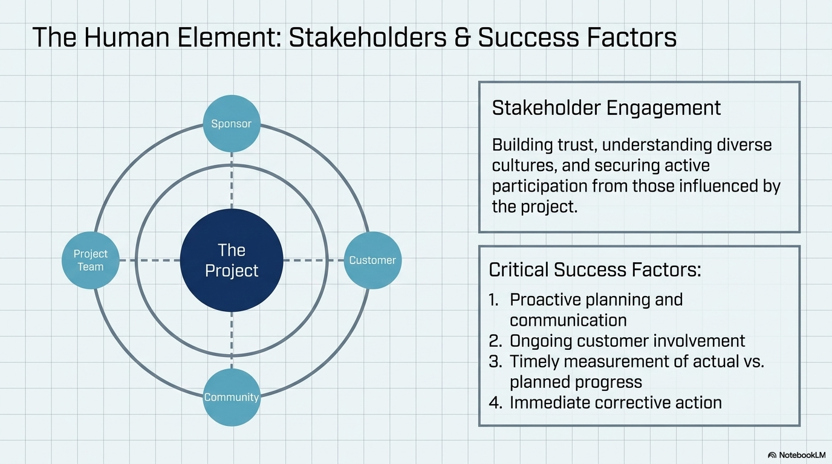
Notes:
Stakeholder engagement
Project stakeholders are individuals and entities involved in, or who may influence, or may be affected by a project, such as the customer/sponsor; project team, including the project manager, subcontractors, and consultants; end users or consumers; and advocacy groups.
Stakeholders include
Customer/sponsor and the project team including subcontractors and suppliers
organisations or groups of people who may be supportive or adversarial or may want to be kept informed about the project because of potential impact
Create a stakeholder register as potential stakeholders are identified and include key contact information, role or specific topics of interest, expectations, any known issues, and areas of potential influence for each stakeholder.
Maintain in issue log of specific issues or concerns or questions that various stakeholders identify so that the project manager, project team, or sponsor/customer can address them and make sure they are not forgotten or dismissed without an adequate follow up and response.

Slide 28
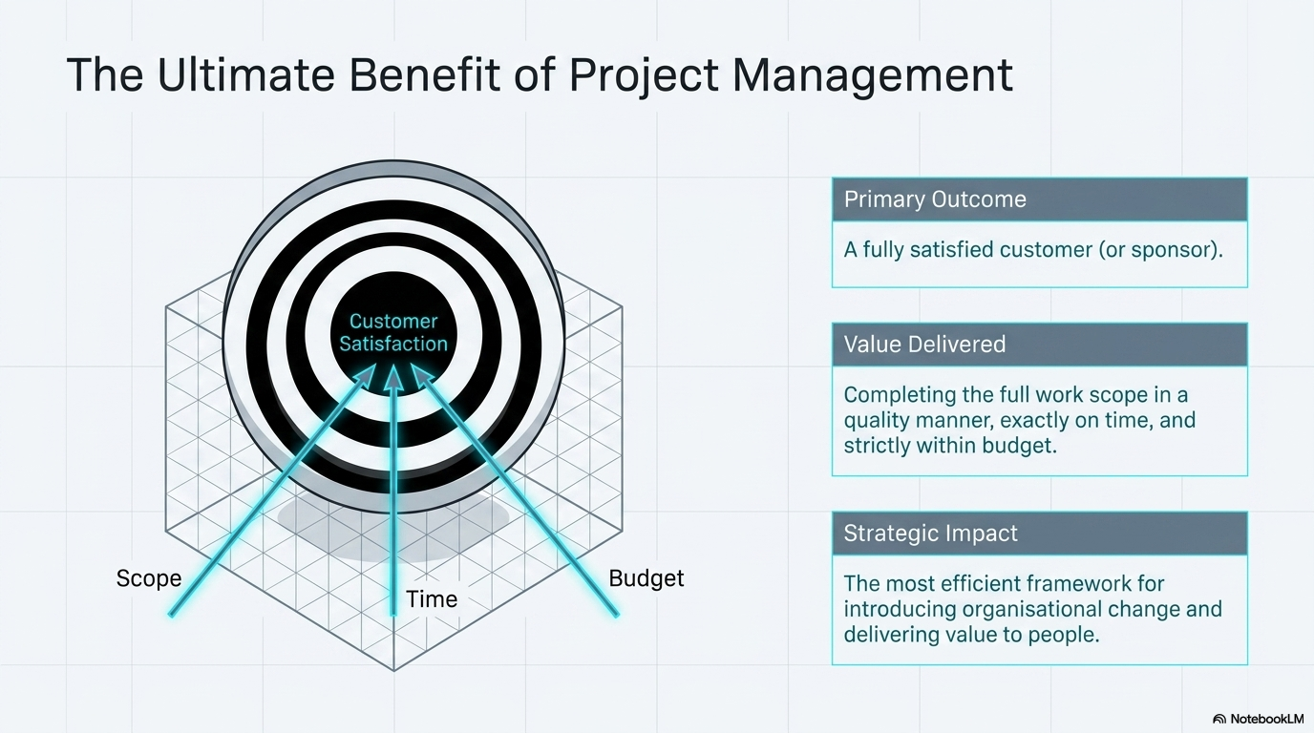
Notes:
The ultimate benefit of implementing project management techniques is having a satisfied customer - Whether you are the customer of your own project, such as renovating your kitchen, or a business being paid by a customer to perform a project.
Completing the full project scope in a quality manner, on time and within budget provides a great feeling of satisfaction and referrals for more business
Project managers have satisfaction, enhanced reputation and expanded career opportunities
Project team members have contributed to the project's success, expanded knowledge and enhanced skills
When projects are successful, everyone wins!

Slide 29


Slide 30
LU1 - Theme 3: Project Management Guides, Frameworks and Methodologies
Differentiate between project management methodologies and standards
Explain the role and benefits of agile project management in an IT project
Discuss agile project management in the context of technology projects
How would you apply the different project management approaches and methodologies in managing an IT project
https://www.dummies.com/article/business-careers-money/business/project-management/agile-project-management-for-dummies-cheat-sheet-208332/
https://www.smartsheet.com/sites/default/files/Agile-PM-101-Beginners-Guide-Non-Project-Managers-Updated.pdf or https://www.smartsheet.com/blog/e-book-agile-project-management-101
http://www.sciencedirect.com/science/article/pii/S187704281402196X

Slide 31
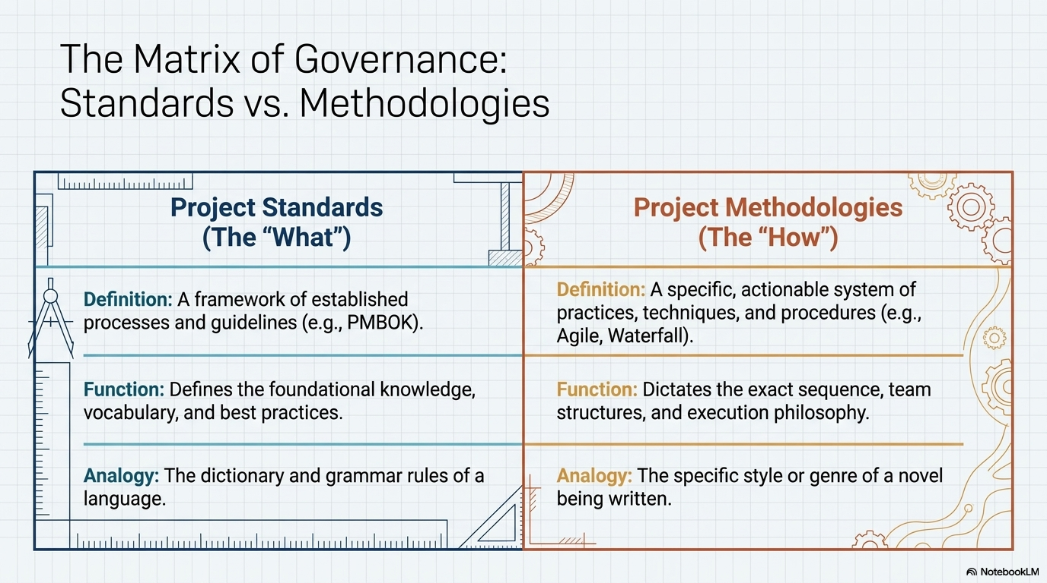
Notes:
Theme 3: Introduction to Project Management Guides, Frameworks and Methodologies
Differentiate between project management methodologies and standards

Slide 32
Project Management Methodologies
Below are the most frequently used project management methodologies in the project management practice:
Adaptive Project Framework
Agile Software Development
Crystal Methods
Dynamic Systems Development Model (DSDM)
Extreme Programming (XP)
Feature Driven Development (FDD)
Information Technology Infrastructure Library (ITIL)
Joint Application Development (JAD)
Lean Development (LD)
PRINCE2
Rapid Application Development (RAD)
Rational Unified Process (RUP)
Scrum
Spiral
Systems Development Life Cycle (SDLC)
Waterfall (Traditional)

Slide 33
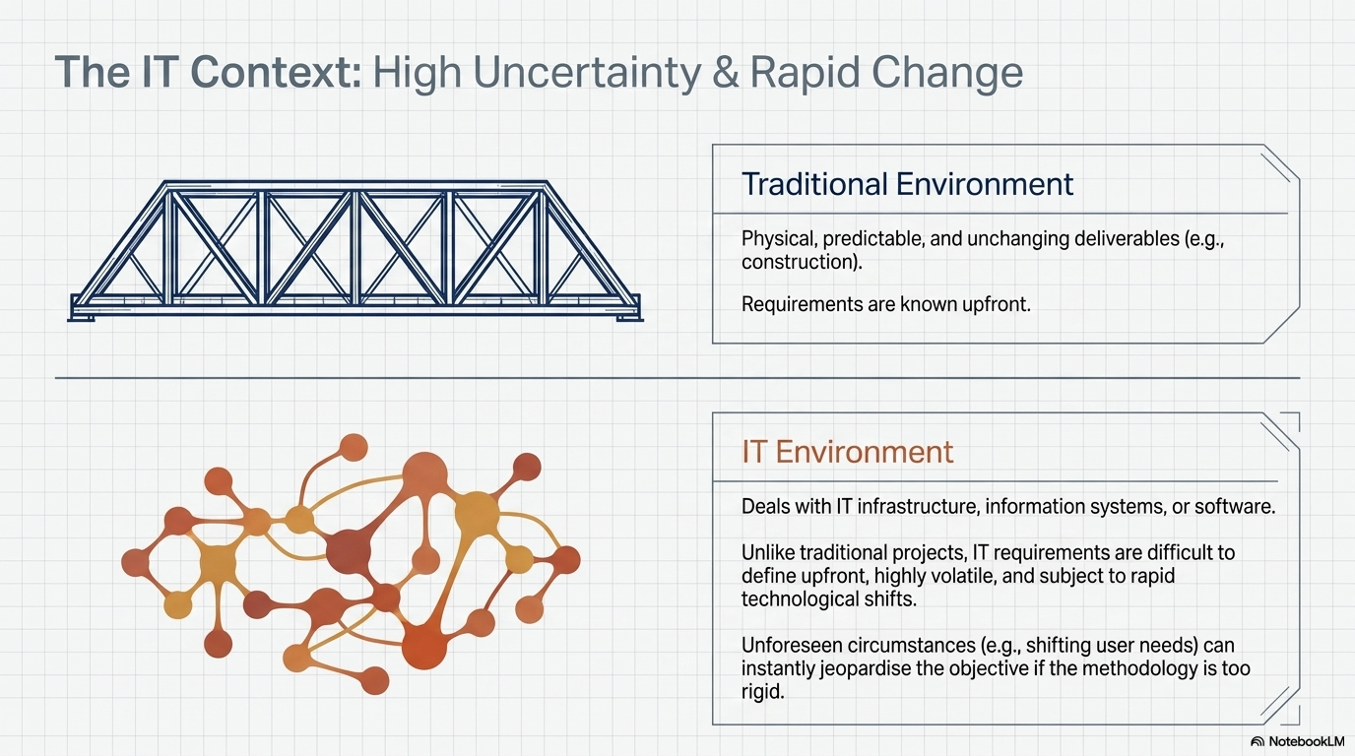
Notes:
Traditional Project Management vs IT Project Management

Slide 34
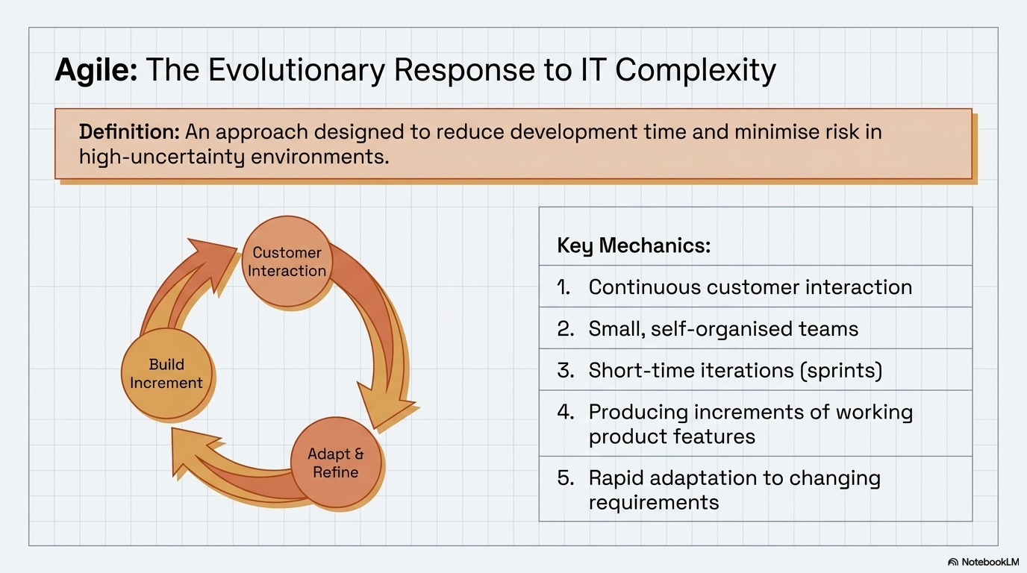
Notes:
Explain the role and benefits of agile project management in an IT project
Discuss agile project management in the context of technology projects

Slide 35
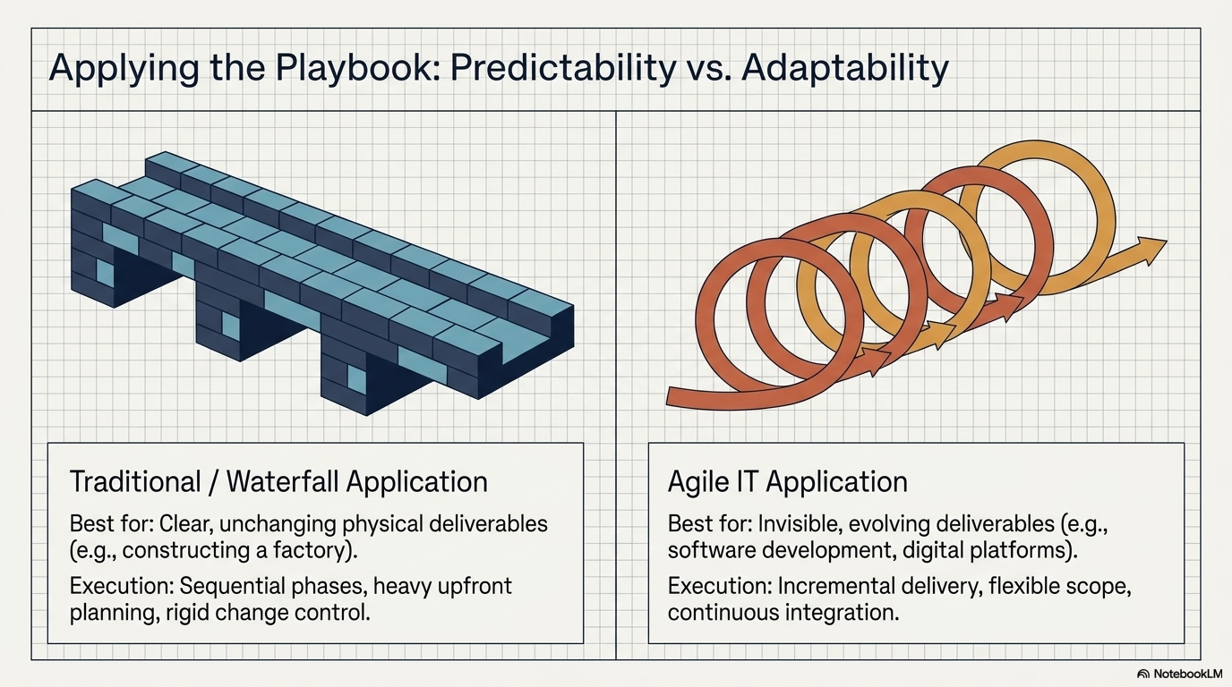
Notes:
1. How would you apply the different project management approaches and methodologies in managing an IT project

Slide 36
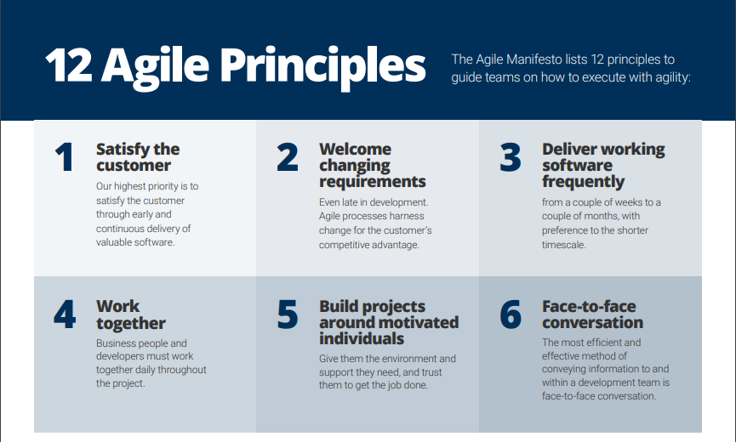

Slide 37
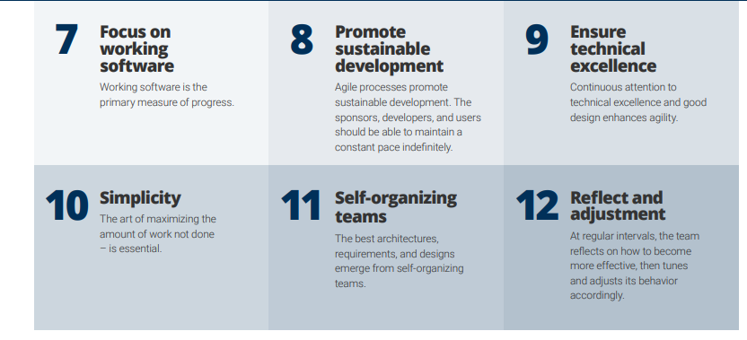

Slide 38
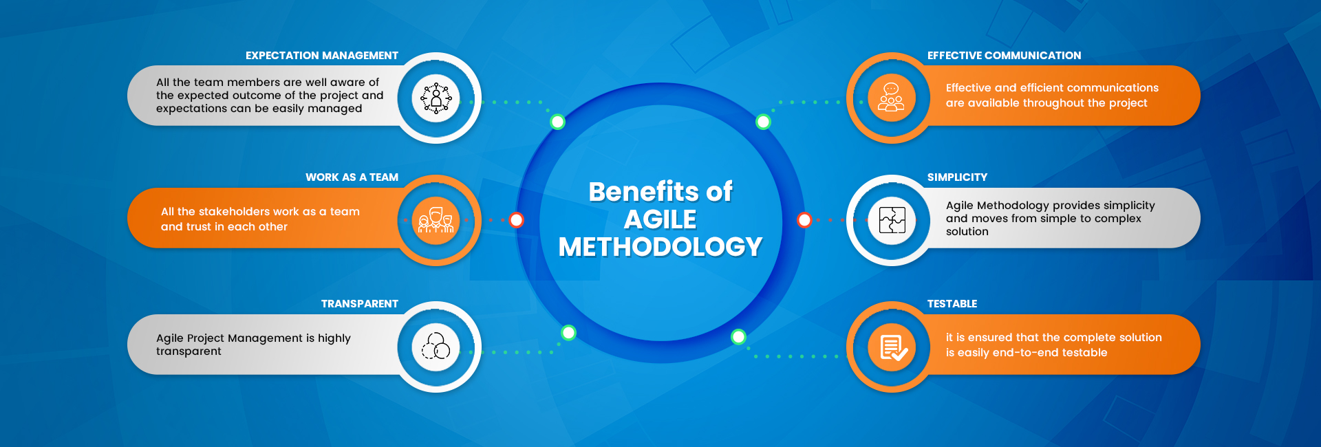
Notes:
Benefits of Agile in IT Projects:
✅ Faster Time-to-Market – Agile enables quick releases of functional software, allowing businesses to respond to market changes faster.
✅ Enhanced Quality – Continuous testing and feedback loops ensure that defects are identified and corrected early.
✅ Higher Stakeholder Satisfaction – Regular interactions with customers ensure that the final product meets their expectations.
✅ Better Risk Management – The iterative approach helps mitigate risks by addressing issues early.
✅ Increased Flexibility – Agile allows teams to pivot based on changing requirements without significant rework.

Slide 39
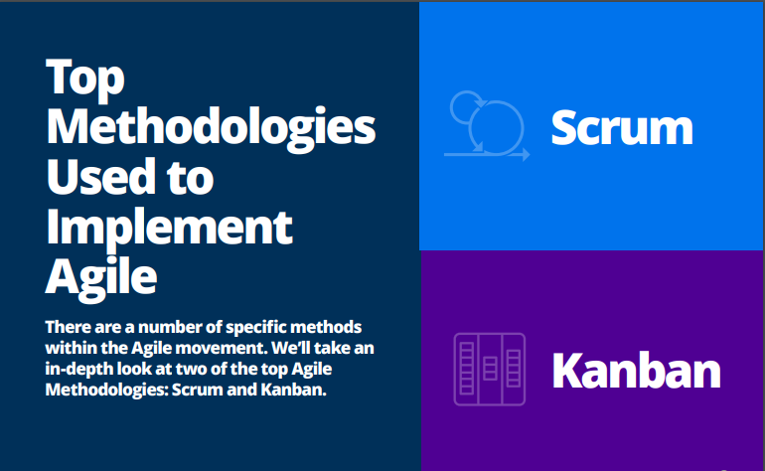

Slide 40
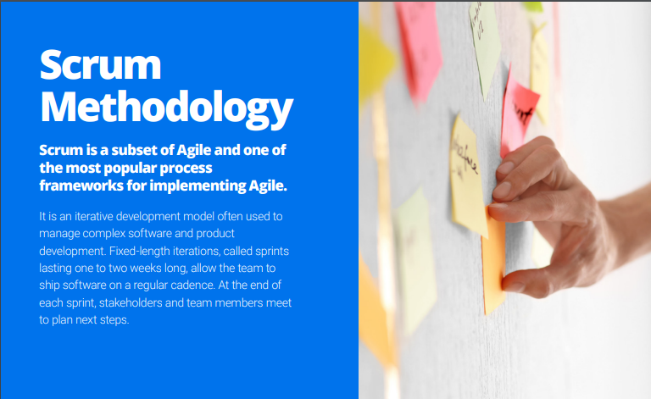
Notes:
Scrum is an agile project management framework that helps teams structure and manage their work through a set of values, principles, and practices.
Scrum is an agile team collaboration framework commonly used in software development and other industries. Scrum prescribes for teams to break work into goals to be completed within time-boxed iterations, called sprints. Each sprint is no longer than one month and commonly lasts two weeks.
Scrum is a framework for getting work done within agile. Scrum uses all the core principles of agile to define methods to facilitate a project.

Slide 41
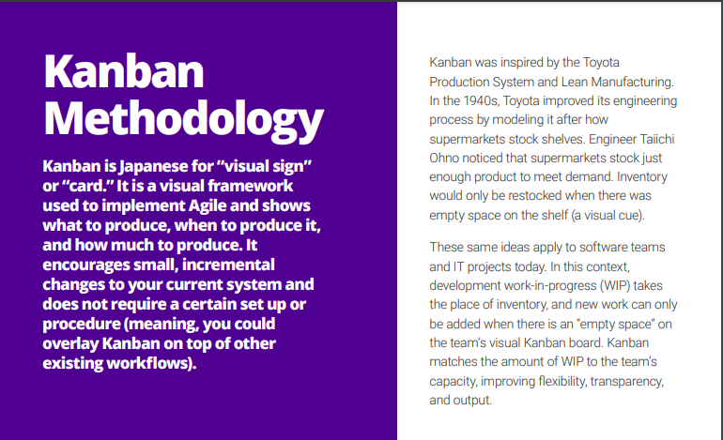
Notes:
Kanban is a popular framework used to implement agile and DevOps software development. It requires real-time communication of capacity and full transparency of work. Work items are represented visually on a kanban board, allowing team members to see the state of every piece of work at any time.

Slide 42
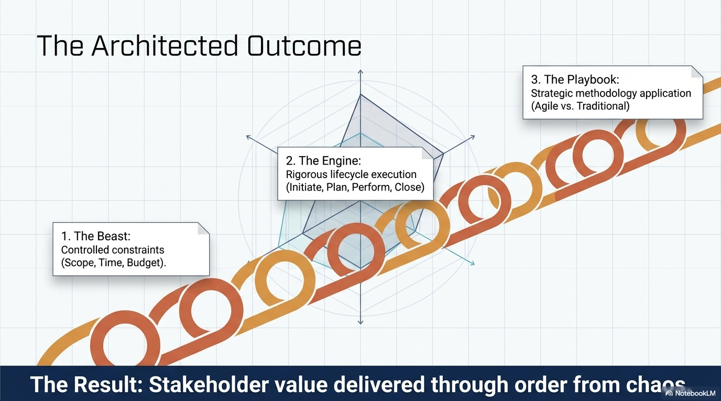
Notes:
Explain the role and benefits of agile project management in an IT project
Discuss agile project management in the context of technology projects
How would you apply the different project management approaches and methodologies in managing an IT project

